Slide 1
“E-Commerce”
SRS for E-commerce

Slide 2
JAASKART
E-com is buying and selling of goods & services , over an electronic network, primarily the internet .
LMS Username | Name | Batch
2115a422 | JAYANTHINATHAN V | A4
2115a44 | ALLEN ROSHAN R | A4
2115a41 | ABDUL LATIF R | A4
2115a444 | SABAREESHWARAN M | A4

Slide 3
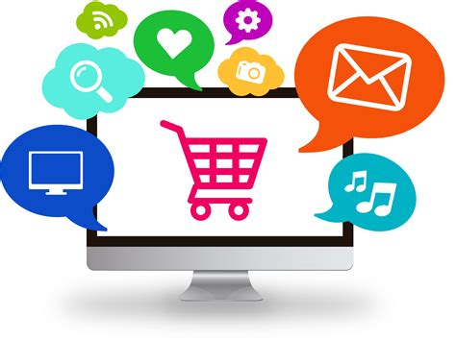
E-commerce(JAASKART)
Outline
What is E-commerce ?
E-commerce Model
Impact of E-commerce
Advantages
E-commerce challenges
E-commerce evolution
Future of E-ecommerce
References

Slide 4
1) What is E-commerce ?
E-commerce (electronic commerce) is the activity of electronically buying or selling of products on online services or over the Internet. E-commerce draws on technologies such as mobile commerce, electronic funds transfer, supply chain management, Internet marketing, online transaction processing, electronic data interchange (EDI), inventory management systems, and automated data collection systems. E-commerce is in turn driven by the technological advances of the semiconductor industry, and is the largest sector of the electronics industry.
Order it…
Get it…

Slide 5

2) Types of E-commerce :
Business-to-Consumer (B2C)
Consumer-to-Business (C2B)
Business-to-Business (B2B)
Consumer-to-Consumer (C2C)
Business-to-Administration (B2A)
Consumer-to-Administration

Slide 6
3) Impact of E-commerce :
The most telling impact of eCommerce on business probably has been the ease of business continuity in the face of a global pandemic that has otherwise led to the closure of several businesses, regardless of size or industry.
Thanks to the convenience offered by online shopping and selling, it was business as usual, in spite of nationwide lockdowns almost all over the world.
The scope of e-Commerce is certainly huge, and we can understand this from the fact that e-commerce sales crossed USD 850 billion last year – 2020, and globally, it’s expected to come close to USD 5 trillion by the end of 2021.
This means that there is a massive opportunity for entrepreneurs in this sector. It presents a plethora of advantages but is not without its drawbacks either. If you own a conventional brick-and-mortar shop, you need to weigh both advantages and disadvantages of e-commerce before you actually venture into it.
This article will definitely give you a fair idea, but you may also need to do some more research before taking the plunge.

Slide 7
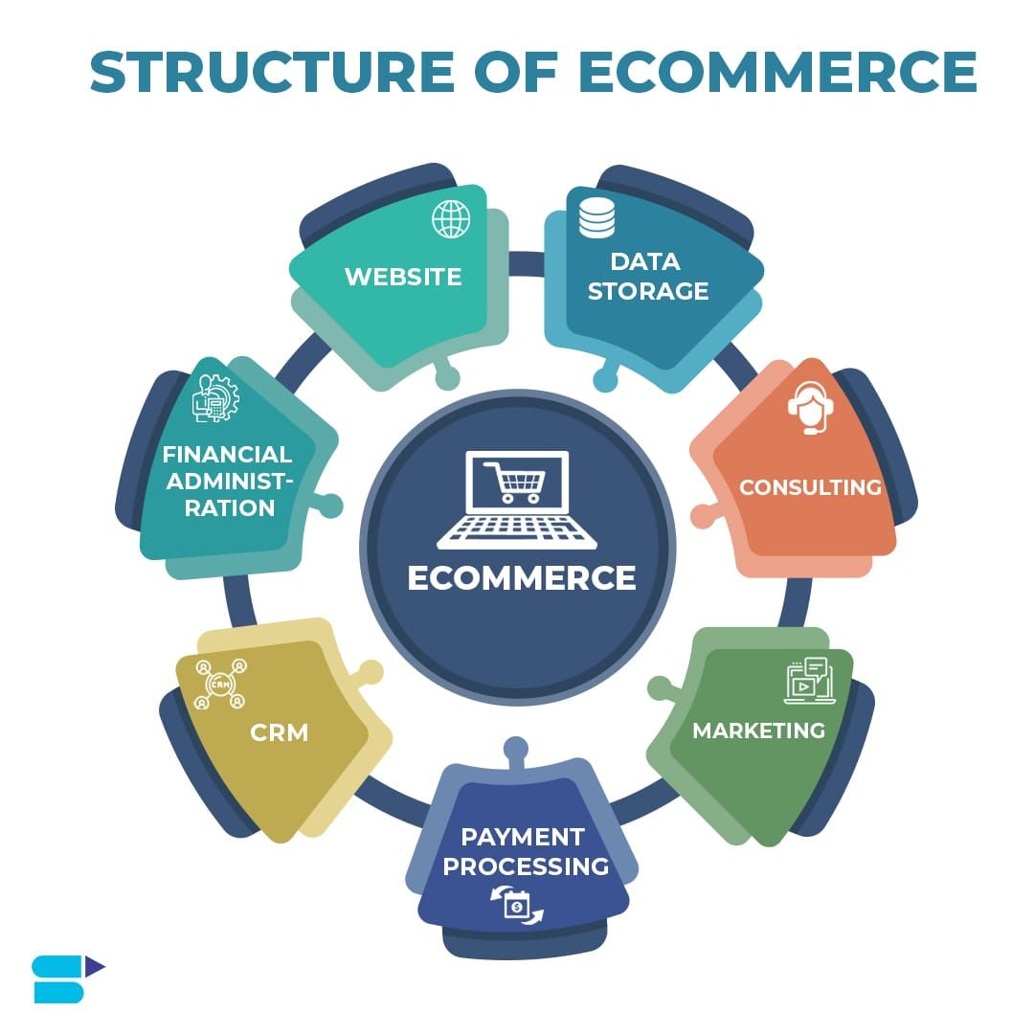
4) Advantages :
Lower prices
Convenient and safe
Wide product variety
More informed decision-making
Saves time
Wider customer base
Easier to scale up
Open always
Flexibility and speed

Slide 8

5) E-commerce challenges :
When it comes to eCommerce, one of the biggest challenges faced is security breaches. There is a lot of information/data that is involved while dealing with eCommerce and a technical issue with data can cause severe damage to the retailer’s daily operations as well as brand image.

Slide 9
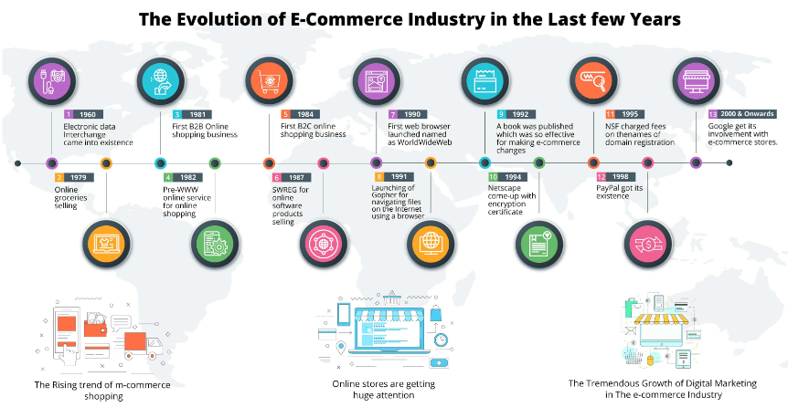
6) E-commerce Evolution over last few years :

Slide 10
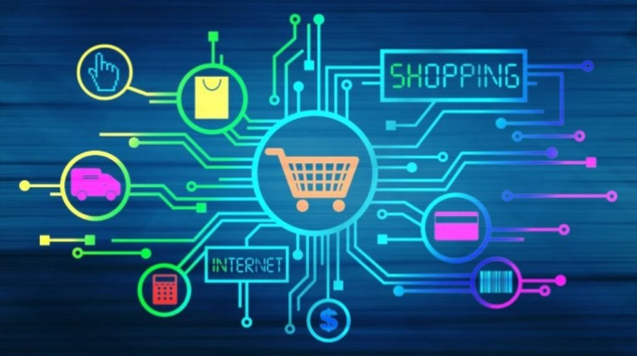
7) Future of ecommerce :
Growth and expansion of online marketplaces
Increased use of mobile devices for ecommerce
Continued focus on personalization and customization
Advances in artificial intelligence and automation

Slide 11
8) References :
"Retail e-commerce sales CAGR forecast in selected countries from 2016 to 2021". Statista. October 2016. Archived from the original on 26 November 2017. Retrieved 4 May 2021.
Wienclaw, Ruth A. (2013). "B2B Business Models" (PDF). Research Starters: Business. Archived (PDF) from the original on 18 July 2013. Retrieved 4 May 2021.
Subramani, Mani; Walden, Eric (June 2001). "The Impact of E-Commerce Announcements on the Market Value of Firms". Information Systems Research. 12 (2):135–154. doi:10.1287/isre.12.2.135.9698. ISSN 1047-7047.

Slide 12
Submission Github
https://github.com/Jayanthinathan02/jayanthinathan_02

Slide 13

JAASKART

